Slide 1
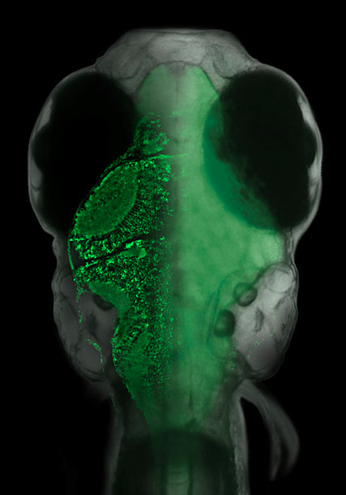
An Agent Based Model of Motor Adaption in Larval Zebrafish
Francis Poole
University of Sussex
Fetcho J.R. 2012. Nature 485:453-5.

Slide 2
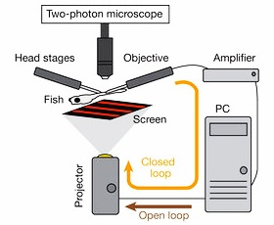
“Virtual Reality” Setup
Ahrens M, et al. 2012. Nature 485:471-7.

Slide 3
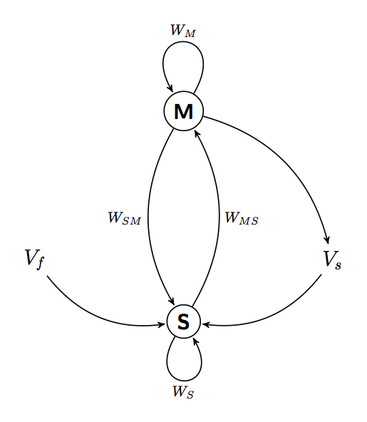
Agent-Based Model

